Slide 1

Cryptography and Information Security

Slide 2
Outline
Cryptographic Techniques review
Vulnerabilities in Network Protocols
Email Security
Web Security
IP security
System Security

Slide 3
Some Basics
Attacks, services and mechanisms
Security attacks
Security services
Security Mechanisms
A model for Internetwork Security

Slide 4
Definitions
Computer Security - generic name for the collection of tools designed to protect data and to stop attackers
Network Security - measures to protect data during their transmission
Information Security – Computer sec + Network sec

Slide 5
Aim of Course
our focus is on Internet Security
consists of measures to prevent, detect, and correct security violations that involve the transmission of information.

Slide 6
Attacks, Services and Mechanisms
Security Attack: Any action that compromises the security of information.
Security Mechanism: A mechanism that is designed to detect, prevent, or recover from a security attack.
Security Service: A service that enhances the security of data processing systems and information transfers. A security service makes use of one or more security mechanisms.

Slide 7
Services, Mechanisms, Attacks
need systematic way to define requirements
consider three aspects of information security:
  security attack
  security mechanism
  security service
consider in reverse order

Slide 8
Security Service
  is something that enhances the security of the data processing systems and the information transfers of an organization.
  intended to counter security attacks.
  make use of one or more security mechanisms to provide the service.

Slide 9
Security Services
Availability
Authentication - assurance that the communicating entity is the one claimed
Access Control - prevention of the unauthorized use of a resource
Data Confidentiality –protection of data from unauthorized disclosure
Data Integrity - assurance that data received is as sent by an authorized entity
Non-Repudiation - protection against denial by one of the parties in a communication

Slide 10
Security Services
Confidentiality (privacy)
Authentication (who created or sent the data)
Integrity (has not been altered)
Non-repudiation (the order is final)
Access control (prevent misuse of resources)
Availability (permanence, non-erasure)
  Denial of Service Attacks
  Virus that deletes files

Slide 11
Security Mechanism
a mechanism that is designed to detect, prevent, or recover from a security attack
no single mechanism that will support all functions required
however one particular element underlies many of the security mechanisms in use: cryptographic techniques
hence our focus on this area

Slide 12
Security Mechanism
specific security mechanisms:
  encipherment, digital signatures, access controls, authentication exchange, traffic padding, routing control etc..

Slide 13
Security Attack
any action that compromises the security of information owned by an organization
information security is about how to prevent attacks, or failing that, to detect attacks on information-based systems
have a wide range of attacks
can focus of generic types of attacks
note: often threat & attack mean same

Slide 14
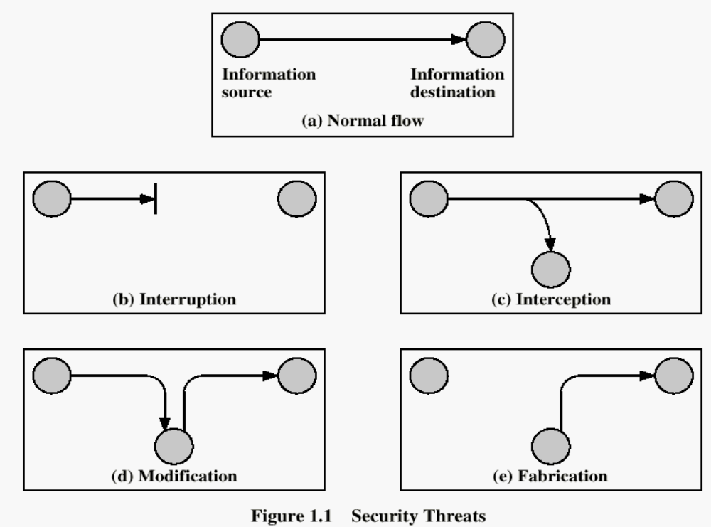
Security Attacks

Slide 15
Security Attacks
Interruption: This is an attack on availability
Interception: This is an attack on confidentiality
Modification: This is an attack on integrity
Fabrication: This is an attack on authenticity

Slide 16
Classify Security Attacks as
passive attacks - eavesdropping on, or monitoring of, transmissions to:
  obtain message contents, or
  monitor traffic flows
active attacks – modification of data stream to:
  masquerade of one entity as some other
  replay previous messages
  modify messages in transit
  denial of service

Slide 17
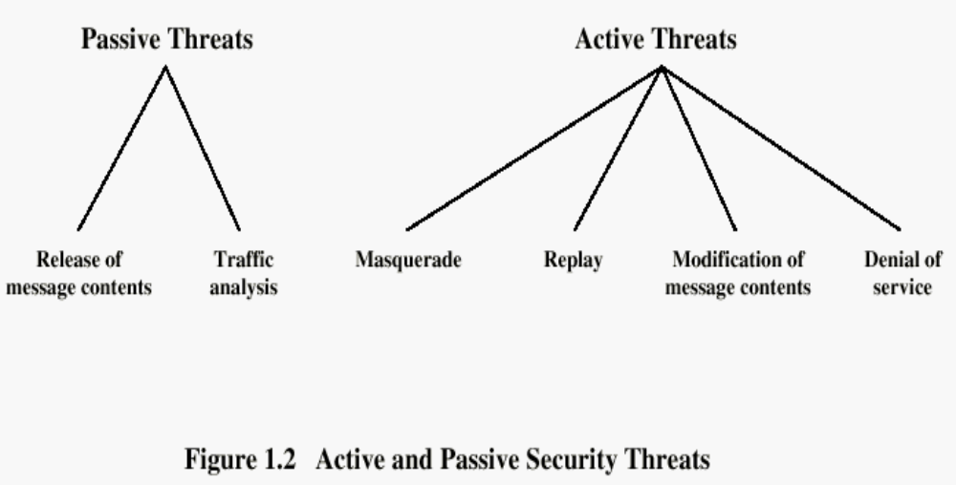

Slide 18
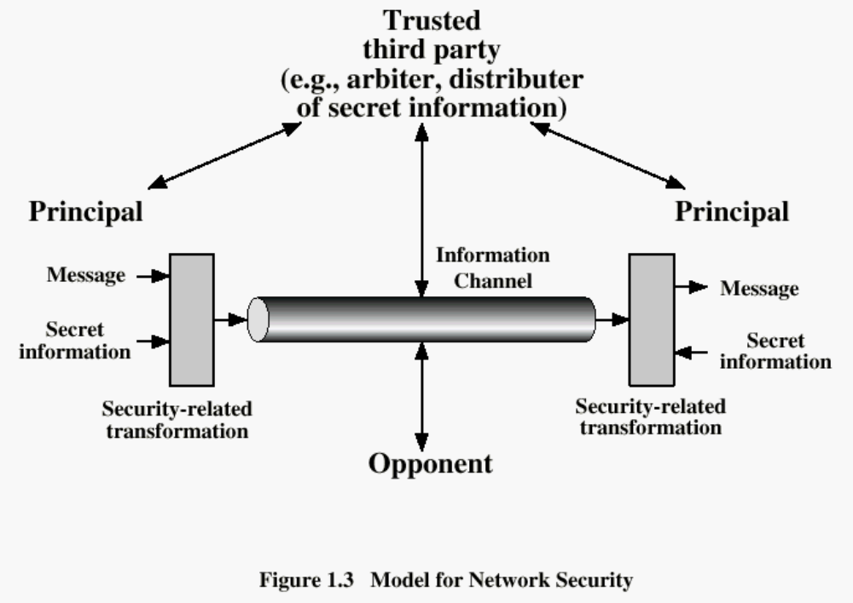

Slide 19
Model for Network Security
using this model requires us to:
  design a suitable algorithm for the security transformation
  generate the secret information (keys) used by the algorithm
  develop methods to distribute and share the secret information
  specify a protocol enabling the principals to use the transformation and secret information for a security service

Slide 20
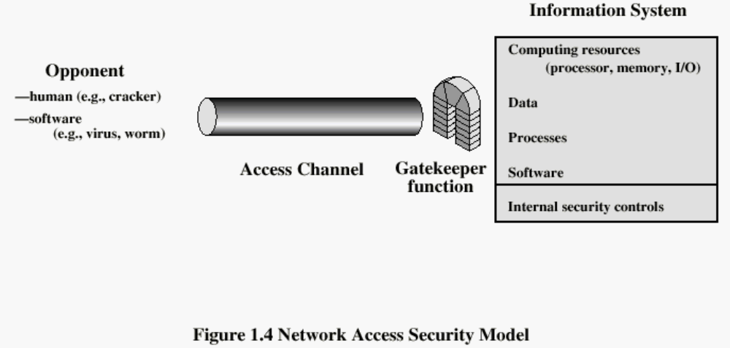

Slide 21
Model for Network Access Security
using this model requires us to:
  select appropriate gatekeeper functions to identify users
  implement security controls to ensure only authorised users access designated information or resources

Slide 22
Summary
have considered:
  computer, network, internet security def’s
  security services, mechanisms, attacks
  -- models for network (access) security

Slide 23
Symmetric Encryption
or conventional / private-key / single-key
sender and recipient share a common key
all classical encryption algorithms are private-key
was only type prior to invention of public-key in 1970’s
Notes:
All traditional schemes are symmetric / single key / private-key encryption algorithms, with a single key, used for both encryption and decryption, since both sender and receiver are equivalent, either can encrypt or decrypt messages using that common key.

Slide 24
Basic Terminology
plaintext - the original message
ciphertext - the coded message
cipher - algorithm for transforming plaintext to ciphertext
key - info used in cipher known only to sender/receiver
encipher (encrypt) - converting plaintext to ciphertext
decipher (decrypt) - converting ciphertext to plaintext
cryptography - study of encryption principles/methods
cryptanalysis (codebreaking) - the study of principles/ methods of deciphering ciphertext without knowing key
cryptology - the field of both cryptography and cryptanalysis
Notes:
Briefly review some terminology used throughout the course.

Slide 25

Symmetric Cipher Model
Notes:
Detail 5 ingredients of the symmetric cipher model:
plaintext
encryption algorithm – performs substitutions/transformations on plaintext
secret key – control exact substitutions/transformations used in encryption algorithm
ciphertext
decryption algorithm – inverse of encryption algorithm

Slide 26
Requirements
two requirements for secure use of symmetric encryption:
  a strong encryption algorithm
  a secret key known only to sender / receiver
  Y = E_{K}(X)
  X = D_{K}(Y)
assume encryption algorithm is known
implies a secure channel to distribute key
Notes:
Generally assume that the algorithm is known.
This allows easy distribution of s/w and h/w implementations.
Hence assume just keeping key secret is sufficient to secure encrypted messages.
Have plaintext X, ciphertext Y, key K, encryption alg Ek, decryption alg Dk.

Slide 27
Types of Cryptanalytic Attacks
ciphertext only
  only know algorithm / ciphertext, statistical, can identify plaintext
known plaintext
  know/suspect plaintext & ciphertext to attack cipher
chosen plaintext
  select plaintext and obtain ciphertext to attack cipher
chosen ciphertext
  select ciphertext and obtain plaintext to attack cipher
chosen text
  select either plaintext or ciphertext to en/decrypt to attack cipher

Slide 28
Cryptography
can characterize by:
  type of encryption operations used
    substitution / transposition / product
  number of keys used
    single-key or private / two-key or public
  way in which plaintext is processed
    block / stream

Slide 29
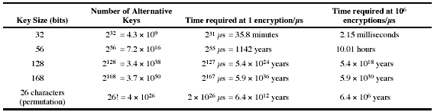
Brute Force Search
always possible to simply try every key
most basic attack, proportional to key size
assume either know / recognise plaintext

Slide 30
More Definitions
unconditional security
  no matter how much computer power is available, the cipher cannot be broken since the ciphertext provides insufficient information to uniquely determine the corresponding plaintext
computational security
  given limited computing resources (eg time needed for calculations is greater than age of universe), the cipher cannot be broken
Notes:
Unconditional security would be nice, but the only known such cipher is the one-time pad (later). For all reasonable encryption algorithms, have to assume computational security where it either takes too long, or is too expensive, to bother breaking the cipher.

Slide 31
Classical Substitution Ciphers
where letters of plaintext are replaced by other letters or by numbers or symbols
or if plaintext is viewed as a sequence of bits, then substitution involves replacing plaintext bit patterns with ciphertext bit patterns
Notes:
In this section and the next, we examine a sampling of what might be called classical encryption
techniques. A study of these techniques enables us to illustrate the basic approaches to
symmetric encryption used today and the types of cryptanalytic attacks that must be anticipated.
The two basic building blocks of all encryption techniques: substitution and transposition.
We examine these in the next two sections. Finally, we discuss a system that combine both
substitution and transposition.

Slide 32
Caesar Cipher
earliest known substitution cipher
by Julius Caesar
first attested use in military affairs
replaces each letter by 3rd letter on
example:
  meet me after the toga party
  PHHW PH DIWHU WKH WRJD SDUWB
Notes:
Substitution ciphers form the first of the fundamental building blocks. The core idea is to replace one basic unit (letter/byte) with another. Whilst the early Greeks described several substitution ciphers, the first attested use in military affairs of one was by Julius Caesar, described by him in Gallic Wars (cf. Kahn pp83-84). Still call any cipher using a simple letter shift a caesar cipher, not just those with shift 3.
Note: when letters are involved, the following conventions are used in this course: Plaintext is always in lowercase; ciphertext is in uppercase; key values are in italicized lowercase.

Slide 33
Caesar Cipher
can define transformation as:
  a b c d e f g h i j k l m n o p q r s t u v w x y z
  D E F G H I J K L M N O P Q R S T U V W X Y Z A B C
mathematically give each letter a number
  a b c d e f g h i j k l m
  0 1 2 3 4 5 6 7 8 9 10 11 12
  n o p q r s t u v w x y Z
  13 14 15 16 17 18 19 20 21 22 23 24 25
then have Caesar cipher as:
  C = E(p) = (p + k) mod (26)
  p = D(C) = (C – k) mod (26)
Notes:
This mathematical description uses modulo arithmetic (ie clock arithmetic). Here, when you reach Z you go back to A and start again. Mod 26 implies that when you reach 26, you use 0 instead (ie the letter after Z, or 25 + 1 goes to A or 0).
Example: howdy (7,14,22,3,24) encrypted using key f (5) is MTBID

Slide 34
Cryptanalysis of Caesar Cipher
only have 26 possible ciphers
  A maps to A,B,..Z
could simply try each in turn
a brute force search
given ciphertext, just try all shifts of letters
do need to recognize when have plaintext
eg. break ciphertext "GCUA VQ DTGCM"
Notes:
With a caesar cipher, there are only 26 possible keys, of which only 25 are of any use, since mapping A to A etc doesn't really obscure the message! cf. basic rule of cryptanalysis "check to ensure the cipher operator hasn't goofed and sent a plaintext message by mistake"!
Can try each of the keys (shifts) in turn, until can recognise the original message. See Stallings Fig 2.3 for example of search.
Note: as mentioned before, do need to be able to recognise when have an original message (ie is it English or whatever). Usually easy for humans, hard for computers. Though if using say compressed data could be much harder.
Example "GCUA VQ DTGCM" when broken gives "easy to break", with a shift of 2 (key C).

Slide 35
Monoalphabetic Cipher
rather than just shifting the alphabet
could shuffle (jumble) the letters arbitrarily
each plaintext letter maps to a different random ciphertext letter
hence key is 26 letters long
  Plain: abcdefghijklmnopqrstuvwxyz
  Cipher: DKVQFIBJWPESCXHTMYAUOLRGZN
  Ciphertext: WIRFRWAJUHYFTSDVFSFUUFYA
  Plaintext: ifwewishtoreplaceletters

Slide 36
Monoalphabetic Cipher Security
now have a total of 26! = 4 x 1026 keys
with so many keys, might think is secure
but would be !!!WRONG!!!
problem is language characteristics

Slide 37
Language Redundancy and Cryptanalysis
human languages are redundant
. letters are not equally commonly used
in English e is by far the most common letter
then T,R,N,I,O,A,S
other letters are fairly rare
cf. Z,J,K,Q,X
have tables of single, double & triple letter frequencies
Notes:
As the example shows, we don't actually need all the letters in order to understand written English text. Here vowels were removed, but they're not the only redundancy. cf written Hebrew has no vowels for same reason. Are usually familiar with "party conversations", can hear one person speaking out of hubbub of many, again because of redundancy in aural language also. This redundancy is also the reason we can compress text files, the computer can derive a more compact encoding without losing any information. Basic idea is to count the relative frequencies of letters, and note the resulting pattern.

Slide 38

English Letter Frequencies
Notes:
This graph is based on counts done at ADFA in the late 1980's, and used to develop the tables published in Seberry & Pieprzyk [SEBE89].
Note that all human languages have varying letter frequencies, though the number of letters and their frequencies varies.
Seberry & Pieprzyk [SEBE89] Appendix A has graphs for 20 languages (most European & Japanese & Malay).

Slide 39
Use in Cryptanalysis
key concept - monoalphabetic substitution ciphers do not change relative letter frequencies
discovered by Arabian scientists in 9th century
calculate letter frequencies for ciphertext
compare counts/plots against known values
for monoalphabetic must identify each letter
  tables of common double/triple letters help
Notes:
The simplicity and strength of the monoalphabetic substitution cipher meant it dominated cryptographic use for the first millenium AD. It was broken by Arabic scientists. The earliest known description is in Abu al-Kindi's "A Manuscript on Deciphering Cryptographic Messages", published in the 9th century but only rediscovered in 1987 in Istanbul, but other later works also attest to their knowledge of the field.

Slide 40
Example Cryptanalysis
given ciphertext:
  UZQSOVUOHXMOPVGPOZPEVSGZWSZOPFPESXUDBMETSXAIZ
  VUEPHZHMDZSHZOWSFPAPPDTSVPQUZWYMXUZUHSX
  EPYEPOPDZSZUFPOMBZWPFUPZHMDJUDTMOHMQ
count relative letter frequencies (see text)
guess P & Z are e and t
guess ZW is th and hence ZWP is the
proceeding with trial and error fially get:
  it was disclosed yesterday that several informal but
  direct contacts have been made with political
  representatives of the viet cong in moscow

